Slide 1
CAR Review, 1Q, 2013
B Scala, J Carlisle, K Huang

Slide 2
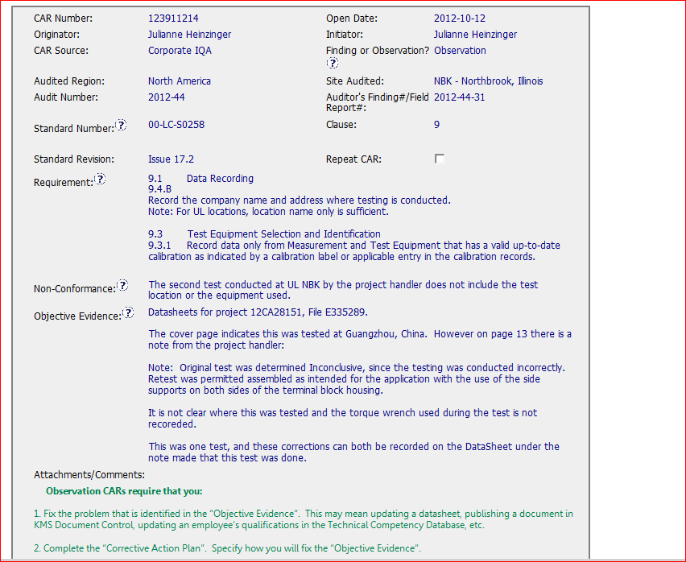
CAR 123911214
Good instruction provided

Slide 3
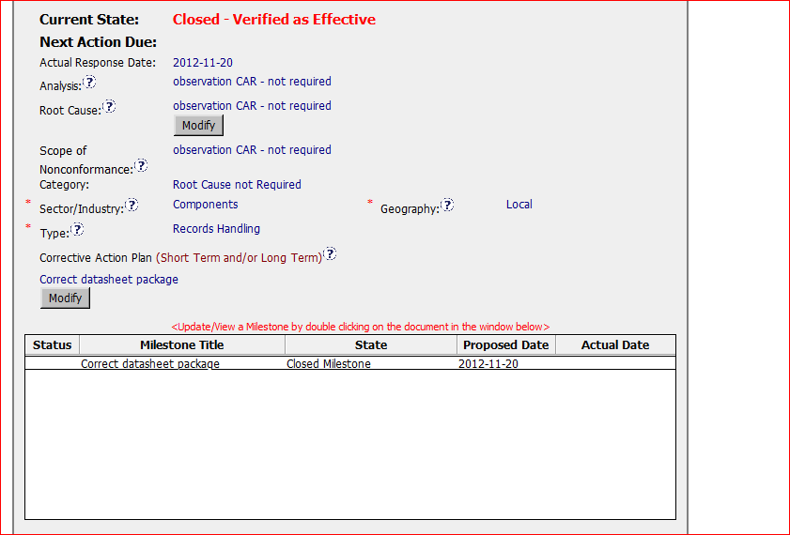
CAR 123911214
Following the procedure regarding to Analysis, Root cause, Scope and category

Slide 4
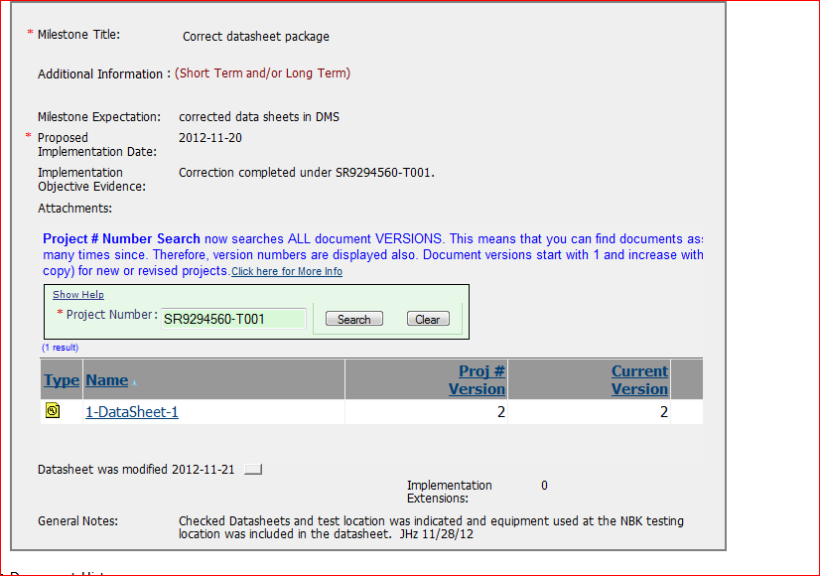
CAR 123911214
Attachment with information from DMS provided as the evidence
Comments

Slide 5
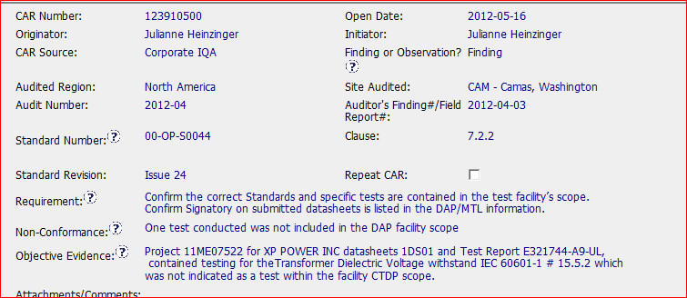
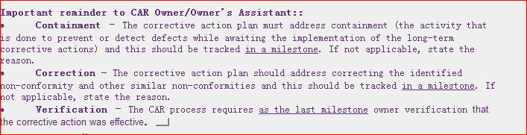
CAR 123910500
Good Information for CAR owner

Slide 6
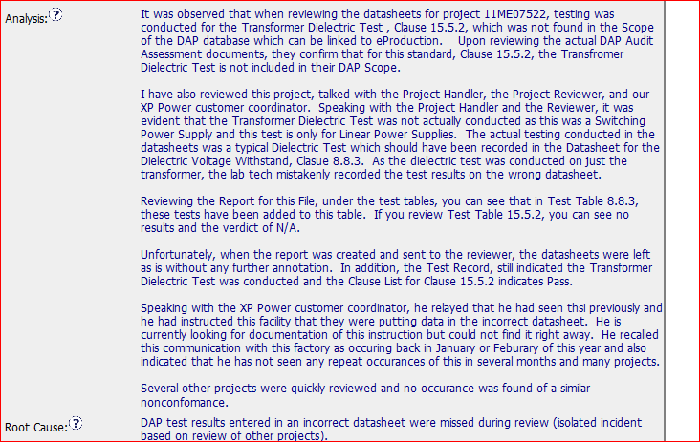
Good Example - CAR 123910500
Identifying the stakeholder
Analysis of scope

Slide 7
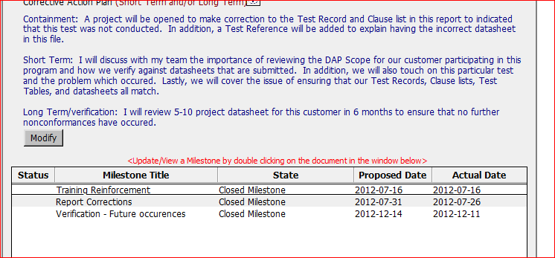
Good Example - CAR 123910500
Having action to prevent it from reoccurrence
Having containment and Verification milestones

Slide 8
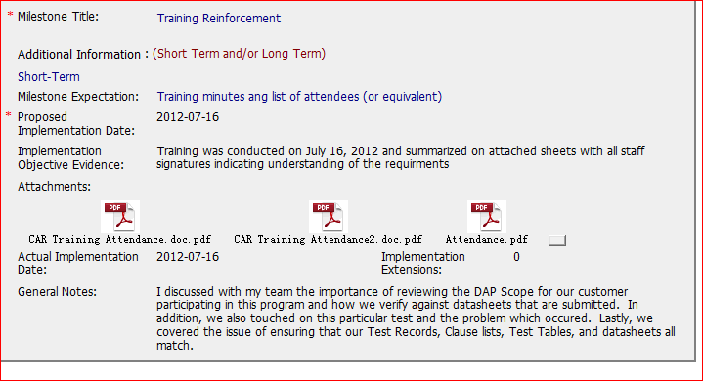
Good Example - CAR 123910500
Including the training content and attendance sheets

Slide 9
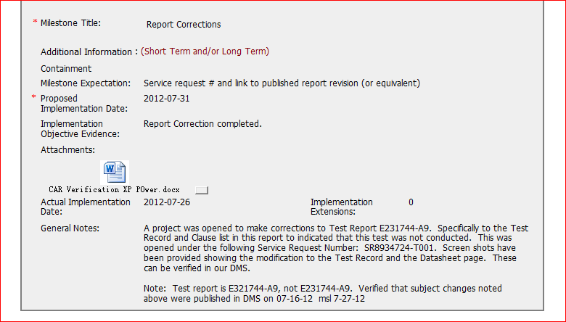
Good Example - CAR 123910500
Having the confirmation information for DMS

Slide 10
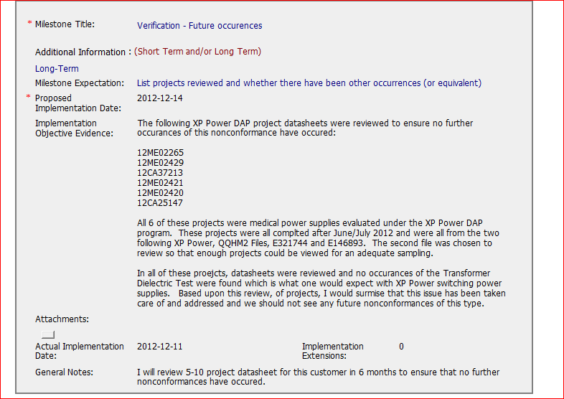
Good Example - CAR 123910500
Having project listed and statement regarding to the verification results

